Slide 1
WHAT IS “TRIZ” ?
A Russian acronym:
Theoria Resheneyva Isobretatelskehuh Zadach
(Theory of Inventive Problem Solving) Problems)
What are these?
®Innovation-TRIZ, 2011

Slide 2
TRIZ
One can think of TRIZ as another way of
Lateral Thinking.
TRIZ is based on two basic principles
--Somebody, sometime, somewhere has already solved your problem or one similar to it. Creativity means finding that solution and adapting it to the current problem.
  --Don’t accept contradictions. Resolve them.
Department of Chemical Engineering, University of Michigan, Ann Arbor

Slide 3
Use the Defect as a Resource
to Solve the Problem
Department of Chemical Engineering, University of Michigan, Ann Arbor

Slide 4
SYSTEM PROPOSAL AND CHALLENGE
Replace inspectors with a $200K video inspection system
High return project, but capital is not available
Boss says, that’s a great idea, but “Find another way!!”
®Innovation-TRIZ, 2011

Slide 5
GOOD PILLS/BAD PILLS
What is IDEALITY/IDEA FINAL RESULT?
We do not want any bad pills in the bottles.
What are the RESOURCES we have?
Can we use the defect as a resource to solve the problem?
®Innovation-TRIZ, 2011

Slide 6

Empty Bath Soap Boxes
Department of Chemical Engineering, University of Michigan, Ann Arbor

Slide 7
Soap Defect
Soap
X-Ray

Slide 8
Empty Bath Soap Boxes
What is IDEALITY/IDEA FINAL RESULT?
We do not want to ship any empty soap boxes
What are the RESOURCES we have?
Can we use the defect as a resource to solve the problem?
®Innovation-TRIZ, 2011

Slide 9
Soap Defect
Soap
Wind

Slide 10
TRIZ Everyday Examples
Automobile air bags deploy quickly to protect the passenger (good),
but
the more rapidly they deploy, the more likely they are to injure or kill small or out-of-position people (bad).
Department of Chemical Engineering, University of Michigan, Ann Arbor

Slide 11
TRIZ Everyday Examples con’t
Cell phone networks should have excellent coverage so users have strong signals (good),
but
cell phone towers are not very nice to look at (bad).
Department of Chemical Engineering, University of Michigan, Ann Arbor

Slide 12
TRIZ Everyday Examples con’t
The email spam filter should be efficient enough to remove all my junk emails (good),
but
then it is more likely to screen some emails that I actually want to receive (bad).
Department of Chemical Engineering, University of Michigan, Ann Arbor

Slide 13
39 TRIZ Features
1: Weight of moving object | 14: Strength | 27: Reliability
2: Weight of stationary object | 15: Durability of moving object | 28: Measurement accuracy
3: Length of moving object | 16: Durability of non moving object | 29: Manufacturing precision
4: Length of stationary object | 17: Temperature | 30: Object-affected harmful
5: Area of moving object | 18: Illumination intensity | 31: Object-generated harmful
6: Area of stationary object | 19: Use of energy by moving object | 32: Ease of manufacture
7: Volume of moving object | 20: Use of energy by stationary object | 33: Ease of operation
8: Volume of stationary object | 21: Power | 34: Ease of repair
9: Speed of object | 22: Loss of Energy | 35: Adaptability or versatility
10: Force (Intensity) | 23: Loss of substance | 36: Device complexity
11: Stress or pressure | 24: Loss of Information | 37: Difficulty of detecting
12: Shape | 25: Loss of Time | 38: Extent of automation
13: Stability of the object | 26: Quantity of substance | 39: Productivity
Department of Chemical Engineering, University of Michigan, Ann Arbor

Slide 14
TRIZ Features
Title | Explanation
Moving objects | Objects which can easily change position in space, either on their own, or as a result of external forces. Vehicles and objects designed to be portable are the basic members of this class.
Stationary objects | Objects which do not change position in space, either on their own, or as a result of external forces. Consider the conditions under which the object is being used.
Department of Chemical Engineering, University of Michigan, Ann Arbor

Slide 15
TRIZ Features
Title | Explanation
1.. Weight of moving object | The mass of the object, in a gravitational field. The force that the body exerts on its support or suspension.
2. Weight of stationary object | The mass of the object, in a gravitational field. The force that the body exerts on its support or suspension, or on the surface on which it rests.
3. Length of moving object | Any one linear dimension, not necessarily the longest, is considered a length.
4. Length of stationary object | Same.
5. Area of moving object | A geometrical characteristic described by the part of a plane enclosed by a line. The part of a surface occupied by the object. OR the square measure of the surface, either internal or external, of an object.
6. Area of stationary object | Same
7. Volume of moving object | The cubic measure of space occupied by the object. Length x width x height for a rectangular object, height x area for a cylinder, etc.
8. Volume of stationary object | Same
Department of Chemical Engineering, University of Michigan, Ann Arbor

Slide 16
TRIZ Web Site
http://www.triz40.com/
Department of Chemical Engineering, University of Michigan, Ann Arbor

Slide 17
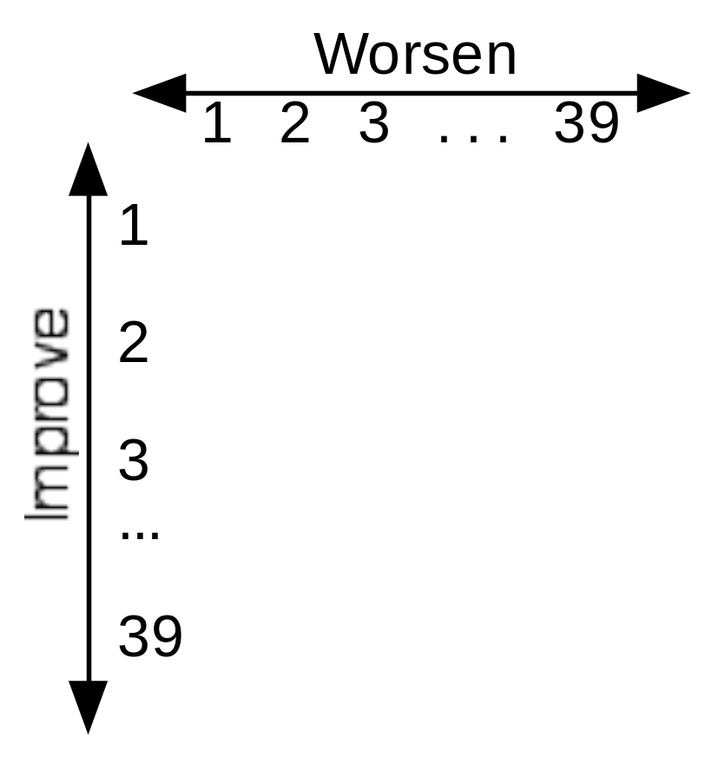
39x39 Contradiction Matrix
Improve
Department of Chemical Engineering, University of Michigan, Ann Arbor

Slide 18
TRIZ Contradiction Matrix
 | Worsening Feature
 |  | 1: Weight of moving object | 2: Weight of stationary object | 3: Length of moving object | 4: Length of stationary object | 5: Area of moving object | 6: Area of stationary object
Improving Feature | 1: Weight of moving object | * | - | 15, 8 | - | 29, 17 | -
 |  |  |  | 29, 34 |  | 38, 34
 | 2: Weight of stationary object | - | * | - | 10, 1 | - | 35, 30
 |  |  |  |  | 29, 35 |  | 13, 2
 | 3: Length of moving object | 8, 15 | - | * | - | 15, 17 | -
 |  | 29, 34 |  |  |  | 4
 | 4: Length of stationary object | - | 35, 28 | - | * | - | 17, 7
 |  |  | 40, 29 |  |  |  | 10, 40
 | 5: Area of moving object | 2, 17 | - | 14, 15 | - | * | -
 |  | 29, 4 |  | 18, 4
 | 6: Area of stationary object | - | 30, 2 | - | 26, 7 | - | *
 |  |  | 14, 18 |  | 9, 39
 | 7: Volume of moving object | 2, 26 | - | 1, 7 | - | 1, 7 | -
 |  | 29, 40 |  | 4, 35 |  | 4, 17
 | 8: Volume of stationary object | - | 35, 10 | 19, 14 | 35, 8 | - | -
 |  |  | 19, 14 |  | 2, 14
 | 9: Speed of object | 2, 28 | - | 13, 14 | - | 29, 30 | -
 |  | 13, 38 |  | 8 |  | 34
 | 10: Force (Intensity) | 8 1 | 18 13 | 17 19 | 28 10 | 19 10 | 1 18
 |  | 37 18 | 1 28 | 9 36 |  | 15 | 36 37
 | 11: Stress or pressure | 10 36 | 13 29 | 35 10 | 35 1 | 10 15 | 10 15
 |  | 37 40 | 10 18 | 36 | 14 16 | 36 28 | 36 37
 | 12: Shape | 8 10 | 15 10 | 29 34 | 13 14 | 5 34 | -
 |  | 29 40 | 26 3 | 5 4 | 10 7 | 4 10
 | 13: Stability of the object | 21 35 | 26 39 | 13 15 | 37 | 2 11 | 39
 |  | 2 39 | 1 40 | 1 28 |  | 13
 | 14: Strength | 1 8 | 40 26 | 1 15 | 15 14 | 3 34 | 9 40
 |  | 40 15 | 27 1 | 8 35 | 28 26 | 40 29 | 28
Department of Chemical Engineering, University of Michigan, Ann Arbor

Slide 19
Altshuller’s 40 Principles of TRIZ
Segmentation
Taking out
Local Quality
Asymmetry
Merging
Universality
“Nested doll”
Anti-weight
Preliminary anti-action
Preliminary action
Beforehand cushioning
Equipotentiality
The other way around
Spheroidality
Dynamics
Partial or excessive actions
Another dimension
Mechanical vibration
Periodic action
Continuity of useful action
Skipping
“Blessing in disguise”
Feedback
‘Intermediary’
Self-service
Copying
Cheap short-living
Mechanics substitution
Pneumatics and hydraulics
Flexible shells and thin films
Porous materials
Color changes
Homogeneity
Discarding and recovering
Parameter changes
Phase transitions
Thermal expansion
Strong oxidants
Inert atmosphere
Composite material films
Department of Chemical Engineering, University of Michigan, Ann Arbor

Slide 20
TRIZ Web Site
http://www.triz40.com/
Department of Chemical Engineering, University of Michigan, Ann Arbor

Slide 21
40 Inventive Principles With Examples
Principle 2. Taking out
Separate an interfering part or property from an object, or single out the only necessary part (or property) of an object.

Slide 22
40 Inventive Principles With Examples
Principle 2. Taking out
Separate an interfering part or property from an object, or single out the only necessary part (or property) of an object.
Locate a noisy compressor outside the building where compressed air is used.
Use fiber optics or a light pipe to separate the hot light source from the location where light is needed.
Use the sound of a barking dog, without the dog, as a burglar alarm.

Slide 23
40 Inventive (Business) Principles With Examples
Principle 7. “Nested Doll”
Place one object inside another; place each object, in turn, inside the other.
Store-in-store (Kinkos FedEx)

Slide 24
40 Inventive (Business) Principles With Examples
Principle 7. “Nested Doll”
Make one part pass through a cavity in the other.
Plug holes in organisation structure
Door sensors count customers into and out of a store/office, etc (use data for market profiling, etc)
Casino hotel architecture (Las Vegas style): The guest must pass through the gaming area to get to the restaurant, the hotel registration, even the lavatories!

Slide 25
Example Application of TRIZ
A New Structural Material for Bullet Proof Garment
Statement: Bullet proof vests should be strong, but not heavy.
Department of Chemical Engineering, University of Michigan, Ann Arbor

Slide 26
Example Application of TRIZ
A New Structural Material for Bullet Proof Garment
Statement: Bullet proof vests should be strong, but not heavy.
Step 1 – Identify the contradiction(s)
Strength (improves) versus Weight (worsens)
Department of Chemical Engineering, University of Michigan, Ann Arbor

Slide 27
Example Application of TRIZ
A New Structural Material for Bullet Proof Garment
Statement: Bullet proof vests should be strong, but not heavy.
Step 1 – Identify the contradiction(s)
Strength (improves) versus Weight (worsens)
Step 2 – Look at the list of features and identify those important to your contradiction.
Strength – #14
Weight – #2
Department of Chemical Engineering, University of Michigan, Ann Arbor

Slide 28
Example Application of TRIZ
A New Structural Material for Bullet Proof Garment
Statement: Bullet proof vests should be strong, but not heavy.
Step 1 – Identify the contradiction(s)
Strength (improves) versus
Weight (worsens)
Step 2 – Look at the list of features and identify those important to your contradiction.
Strength – #14
Weight – #2
Step 3 Identify Which Are Improving Features and Which Are Worsening Features
Strength (feature 14) improves
Weight (feature 2) worsens
Department of Chemical Engineering, University of Michigan, Ann Arbor

Slide 29
 | 2: Weight of stationary object
1: Weight of moving object | *
2: Weight of stationary object | -
3: Length of moving object | 8, 15
 | 29, 34
4: Length of stationary object | -
5: Area of moving object | 2, 17
 | 29, 4
6: Area of stationary object | -
7: Volume of moving object | 2, 26
 | 29, 40
8: Volume of stationary object | -
9: Speed of object | 2, 28
 | 13, 38
10: Force (Intensity) | 8 1
 | 37 18
11: Stress or pressure | 10 36
 | 37 40
12: Shape | 8 10
 | 29 40
13: Stability of the object | 21 35
 | 2 39
14: Strength | 40,26
 | 27,1
Department of Chemical Engineering, University of Michigan, Ann Arbor

Slide 30
Example Application of TRIZ
A New Structural Material for Bullet Proof Garment
Step 4 –
Refer to the TRIZ Contradiction Matrix to learn which of Altshuller’s Principles may be useful for this problem.
The intersection of Column 2 and Row 14 gives the following principles
1
26
27
40
Department of Chemical Engineering, University of Michigan, Ann Arbor

Slide 31
Altshuller’s 40 Principles of TRIZ
Segmentation
Taking out
Local Quality
Asymmetry
Merging
Universality
“Nested doll”
Anti-weight
Preliminary anti-action
Preliminary action
Beforehand cushioning
Equipotentiality
The other way around
Spheroidality
Dynamics
Partial or excessive actions
Another dimension
Mechanical vibration
Periodic action
Continuity of useful action
Skipping
“Blessing in disguise”
Feedback
‘Intermediary’
Self-service
Copying
Cheap short-living
Mechanics substitution
Pneumatics and hydraulics
Flexible shells and thin films
Porous materials
Color changes
Homogeneity
Discarding and recovering
Parameter changes
Phase transitions
Thermal expansion
Strong oxidants
Inert atmosphere
Composite material films
Department of Chemical Engineering, University of Michigan, Ann Arbor

Slide 32
Example Application of TRIZ
A New Structural Material for Bullet Proof Garment
Step 4 –
Refer to the TRIZ Contradiction Matrix to learn which of Altshuller’s Principles may be useful for this problem.
Row 14 (Strength) and Column 2 (Weight) of the Contradiction Matrix indicate the following Principles may be useful: 40, 26, 27, and 1. We now look at the Principles list to learn that these numbers correspond to
1. Segmentation.
26. Copying
27. Cheap short living
40. Composite materials
Next we brainstorm how we could use these four Principles to solve our problem.
Department of Chemical Engineering, University of Michigan, Ann Arbor

Slide 33
40 Inventive Principles With Examples
Principle 1. Segmentation
A. Divide an object into independent parts.

Slide 34
40 Inventive Principles With Examples
Principle 1. Segmentation
A. Divide an object into independent parts.
Replace mainframe computer by personal computers.
Replace a large truck by a truck and trailer.
Use a work breakdown structure for a large project.
B. Make an object easy to disassemble.

Slide 35
40 Inventive (Business) Principles With Examples
Principle 1. Segmentation
B. Make an object easy to disassemble.
Use of temporary workers on short-term projects
Flexible Manufacturing Systems
Modular furniture/offices
Container shipment
C. Increase the degree of fragmentation or segmentation.
‘Empowerment’ - segmentation of decision making.
Distance learning (also ‘Taking Out’)
Virtual office/remote working (also ‘Taking Out’)

Slide 36
Example Application of TRIZ
A New Structural Material for Bullet Proof Garment
1. Segmentation
Perhaps we could consider several different coverings for different parts of the body (pants, vest, etc.) rather than a one-piece suit.
Maybe different materials to cover the critical areas such as chest and head, each taking advantage of specific properties that would be customized for their differing applications.
Department of Chemical Engineering, University of Michigan, Ann Arbor

Slide 37
Example Application of TRIZ
A New Structural Material for Bullet Proof Garment
26. Copying
The explanation of this Principle from the TRIZ website is:
  Instead of an unavailable, expensive, fragile object, use simpler and inexpensive copies.
  Replace an object, or process with optical copies.
We could copy the design of abbreviated scuba diving wet suits for use as a bullet proof garment.
Department of Chemical Engineering, University of Michigan, Ann Arbor

Slide 38
Example Application of TRIZ
A New Structural Material for Bullet Proof Garment
27. Cheap short-living objects
The explanation of this Principle from the TRIZ website is:
  Replace an inexpensive object with a multiple of inexpensive objects, comprising certain qualities (such as service life, for instance).
This Principle does not appear to be readily applicable to this problem. This occurance is not necessarily unusual, because these Principles are only general suggestions to help focus our thinking in areas that have proven fruitful in previous problems.
Department of Chemical Engineering, University of Michigan, Ann Arbor

Slide 39
Example Application of TRIZ
A New Structural Material for Bullet Proof Garment
40. Composite materials
The explanation of this Principle from the TRIZ website is:
  Change from uniform to composite (multiple) materials.
  - Composite epoxy resin/carbon fiber golf club shafts are lighter, stronger, and more flexible than metal. Same for airplane parts.
  - Fiberglass surfboards are lighter and more controllable and easier to form into a variety of shapes than wooden
For lighter-weight, stronger vests, the use of composites
is an active area of research.
Polymers (Kevlar) reinforced with carbon nanofibers are currently being investigated as a strong lightweight alternative to steel for structural materials.
Department of Chemical Engineering, University of Michigan, Ann Arbor

Slide 40
TRIZ
Kevlar vests are now common place among police officers and soldiers
Epilog
By identifying problem contradictions, the elements of TRIZ can be used to help reach a solution. Using the TRIZ method, we were able to generate two additional ideas.
TRIZ Motto: If the tools of TRIZ are used in an effective manner the major challenges of today will be resolved more rapidly to produce the success stories of tomorrow.
Department of Chemical Engineering, University of Michigan, Ann Arbor

Slide 41
The Boeing 737
A TRIZ problem solving team was called to the Boeing factor in Seattle, Washington to see how the capacity of the Boeing 737-100 could be increased.
Department of Chemical Engineering, University of Michigan, Ann Arbor

Slide 42
The airplane engine is the moving object. We would need the engine air intake and the fuel injection casing to be larger so the improving feature is engine volume. the but if we increase the volume of the engine it will decrease the clearance distance between the bottom of the engine and the ground (worsening feature). The improving feature is number 7.“Volume of moving object (engine) and the worsening feature is “3. Length (diameter) of the moving object (clearance).
Department of Chemical Engineering, University of Michigan, Ann Arbor

Slide 43
Solution to Boeing 737
Department of Chemical Engineering, University of Michigan, Ann Arbor

Slide 44
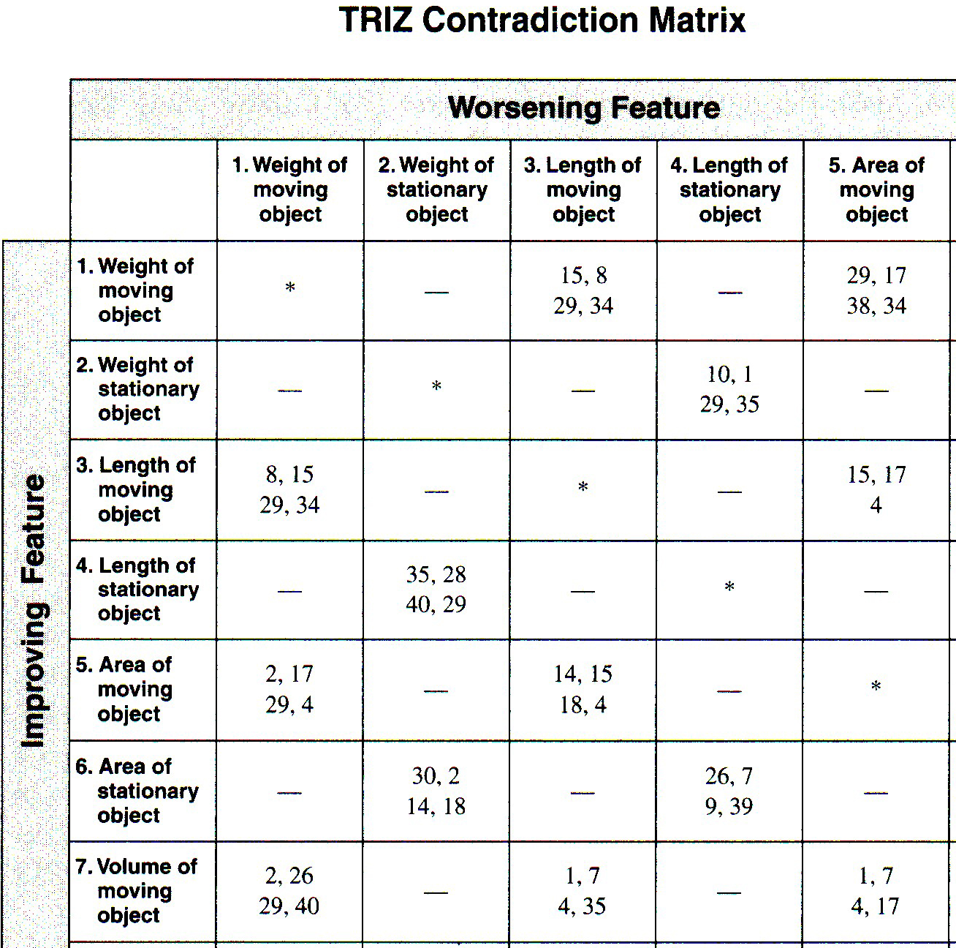

Slide 45
The engine intake area and the cowl with the fuel lines make up the engine volume, thus an improving feature will be the “7. Volume of the moving object” and the worsening feature again “3. Length (engine diameter, i.e., clearance).” This intersection gives
4. Asymmetry
1. Segmentation
7. Nested Dolls
35. Parameter Changes
Department of Chemical Engineering, University of Michigan, Ann Arbor

Slide 46
We note the 737-200 engines are circular in both the intake area and the area plus the casing.
Now let’s look at Atlshuler Principle 1. Segmentation.
We have the engine air intake area and the area of the casing surrounding the intake. The intake area must be circular because of the spinning blades inside the engine.
Department of Chemical Engineering, University of Michigan, Ann Arbor

Slide 47
Now let’s look at the principle number 4. Asymmetry.
Does the intake area plus the casing need to be symmetric? No it does not.
Department of Chemical Engineering, University of Michigan, Ann Arbor

Slide 48
Let’s look at number 7. Nesting.
Could the symmetrical blades and moving parts be “nested” inside an asymmetrical casing?
What if we were to make the air intake area symmetrical but make the casing plus intake area asymmetrical so as to flatten the bottom and thus leave a great clearance?
If you look at the engines of the new 737s you will notice this solution was implemented.
Department of Chemical Engineering, University of Michigan, Ann Arbor

Slide 49
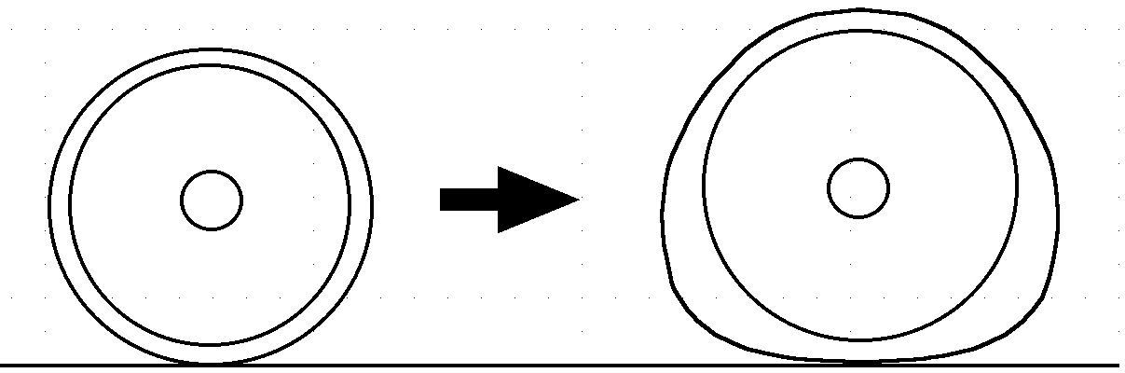
Department of Chemical Engineering, University of Michigan, Ann Arbor

Slide 50
Solution : Cylindrical Intake but Oval Engine Casing

